Slide 1
Building an Open Bioeconomy
Jacob Beal
iGEM Open Talks
Online; September, 2021

Slide 2


Synthetic Biology is driving the bioeconomy
Who is going to own it and who is it going to serve?

Slide 3
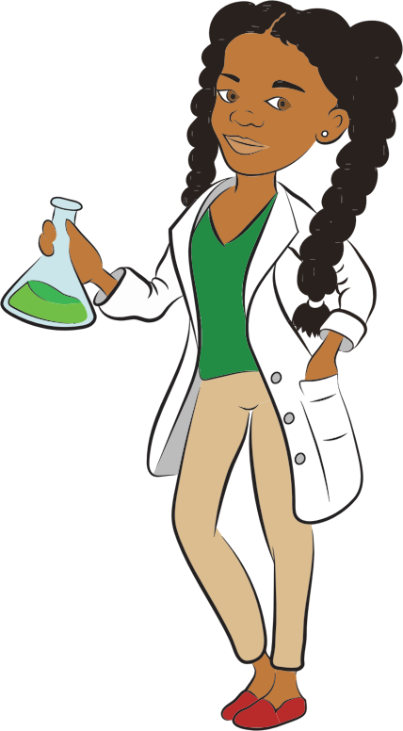



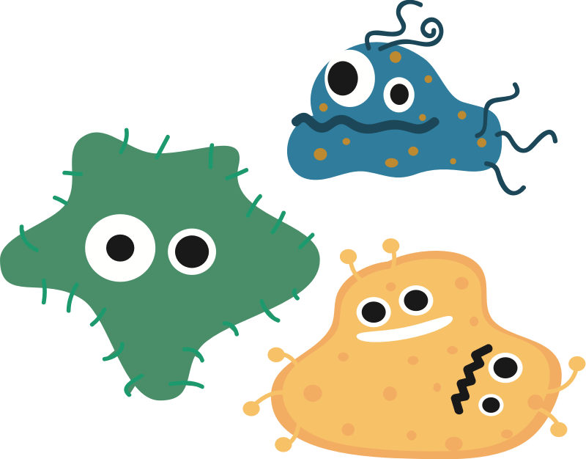
Balancing Open and Proprietary
Bad Proprietary:
Control of Infrastructure
Good Proprietary:
Products & Services
Enabling Infrastructure

Slide 4
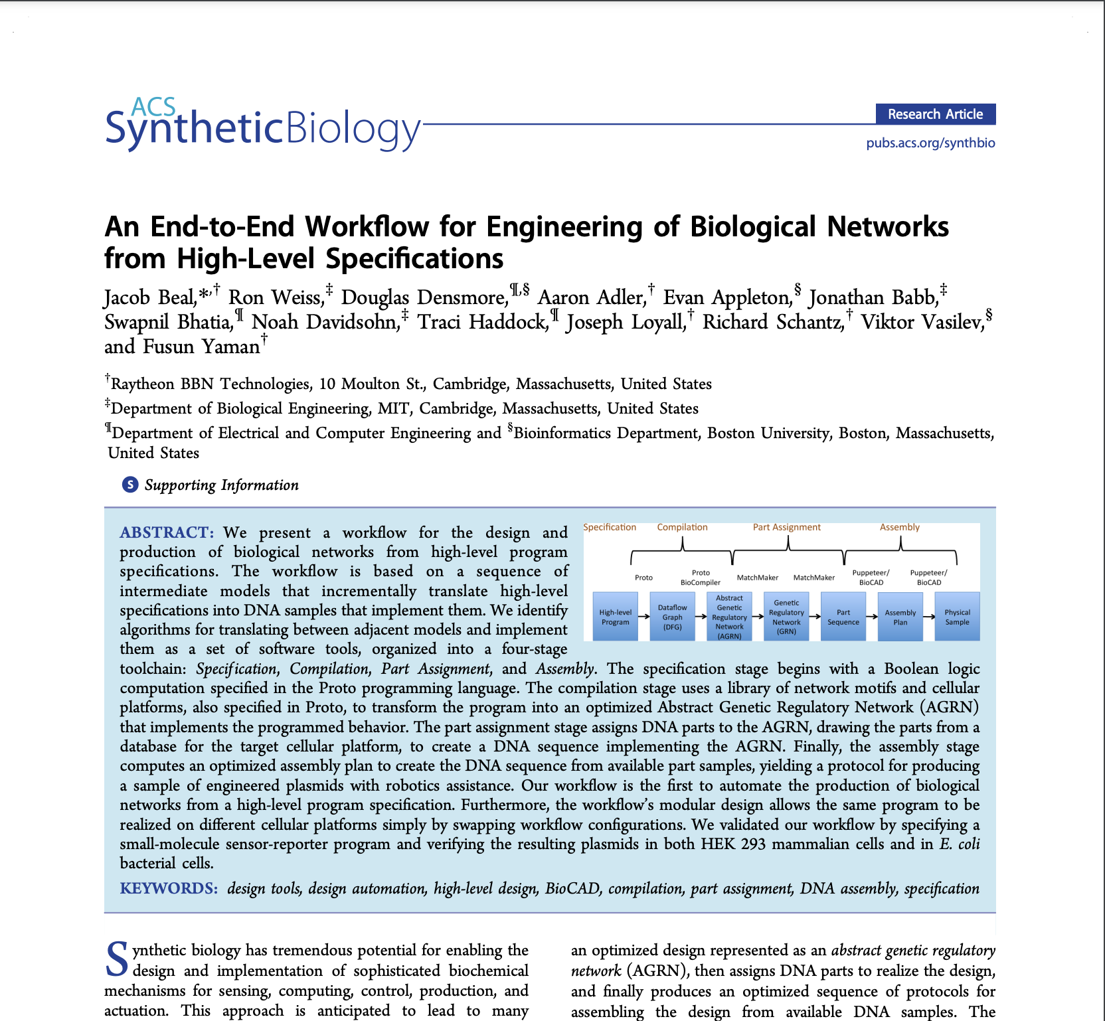

Why I almost quit synthetic biology
Nice paper. Shame if anybody noticed your patent violations.

Slide 5
How do we ensure open infrastructure?
Where has it worked?
Network protocols
Programming languages
Server software
Web browsers
Large organizations need them
Open markets, innovation
Where has it failed?
App stores
Social media
Online sales
Advertising / search
Direct sales to consumers
Oligopolies, crashing markets
Libre ≠ Gratis
Open infrastructure was never assured (c.f., Microsoft)
Key: critical mass of pre-competitive value

Slide 6
SynBio is approaching a major transition
Predictable Design
NOW
Calibrated assays →
SNR, models, …
2010s
BioBricks →
GG, MoClo, BASIC, …
2000s
[Endy, Science ‘05; Beal et al., TIBTECH ’18]

Slide 7
The Universal Foundation of Engineering
Control uncertainty enough for a reasonable chance of success…
Pragmatic
models
predicted acceptable range
with model error
Better
devices
estimated property value
with measurement error
Calibrated
measurement

Slide 8
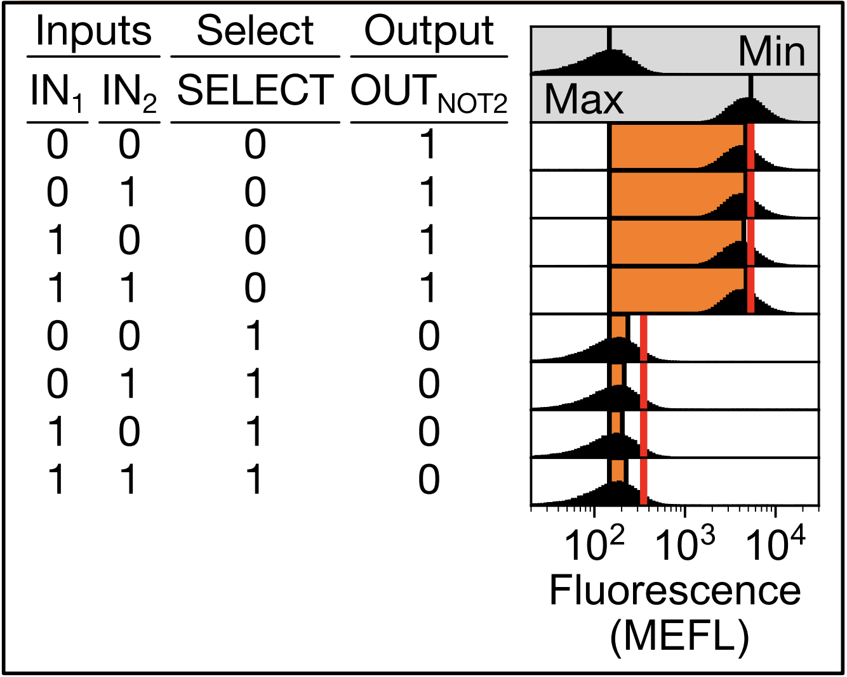
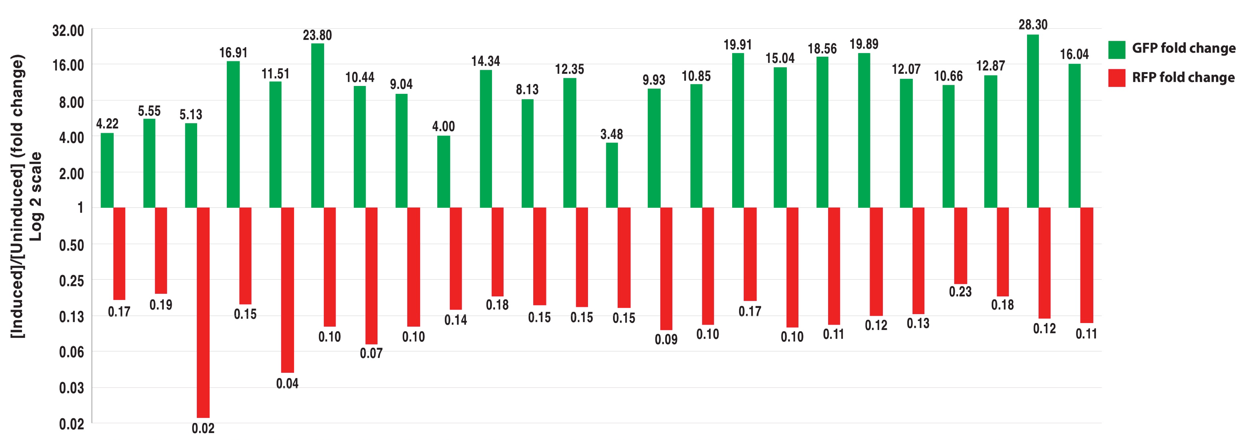
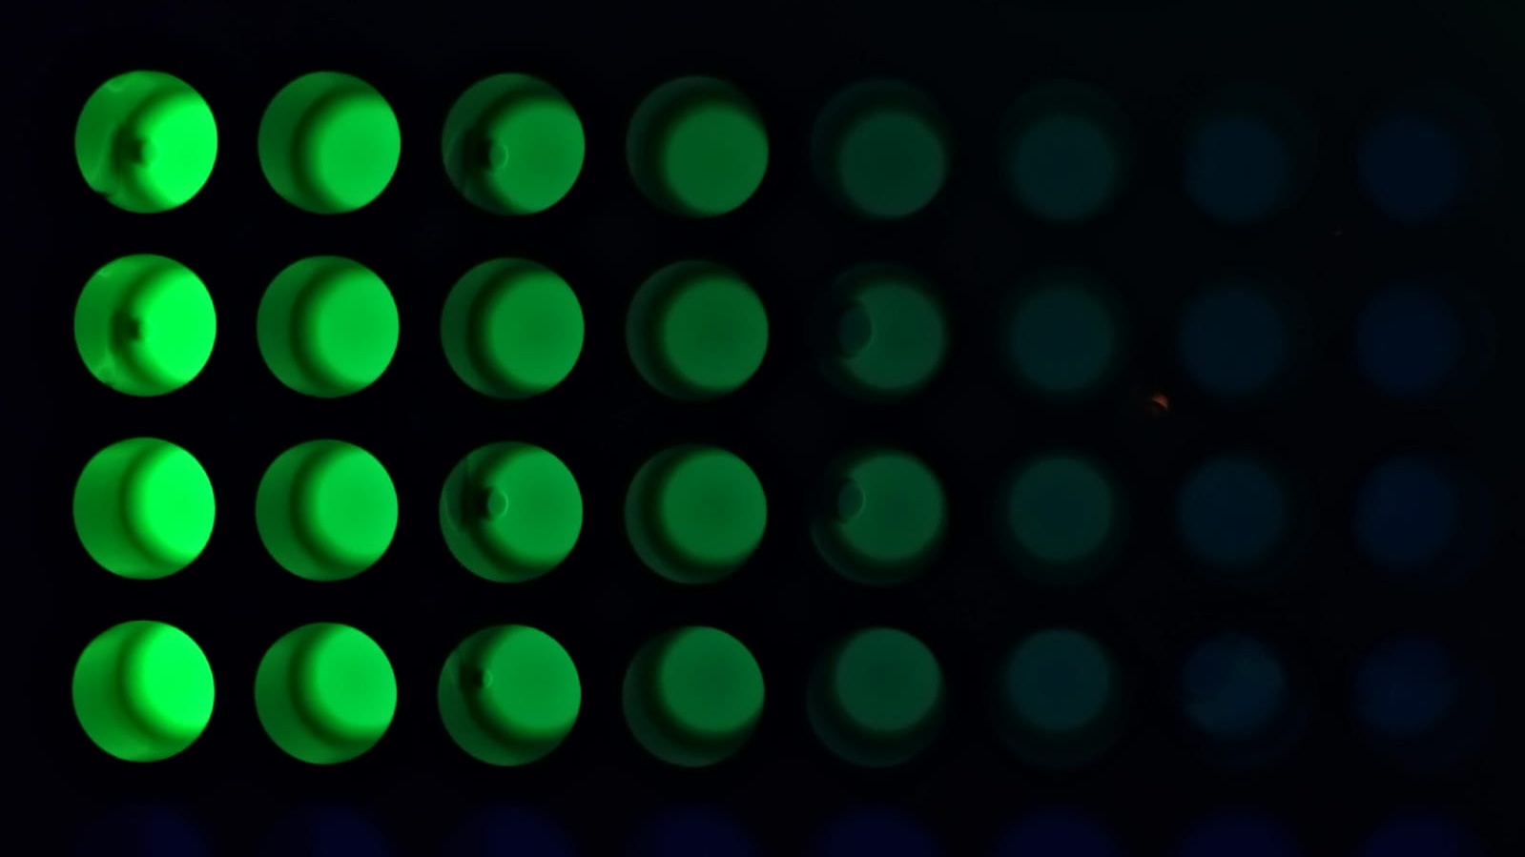
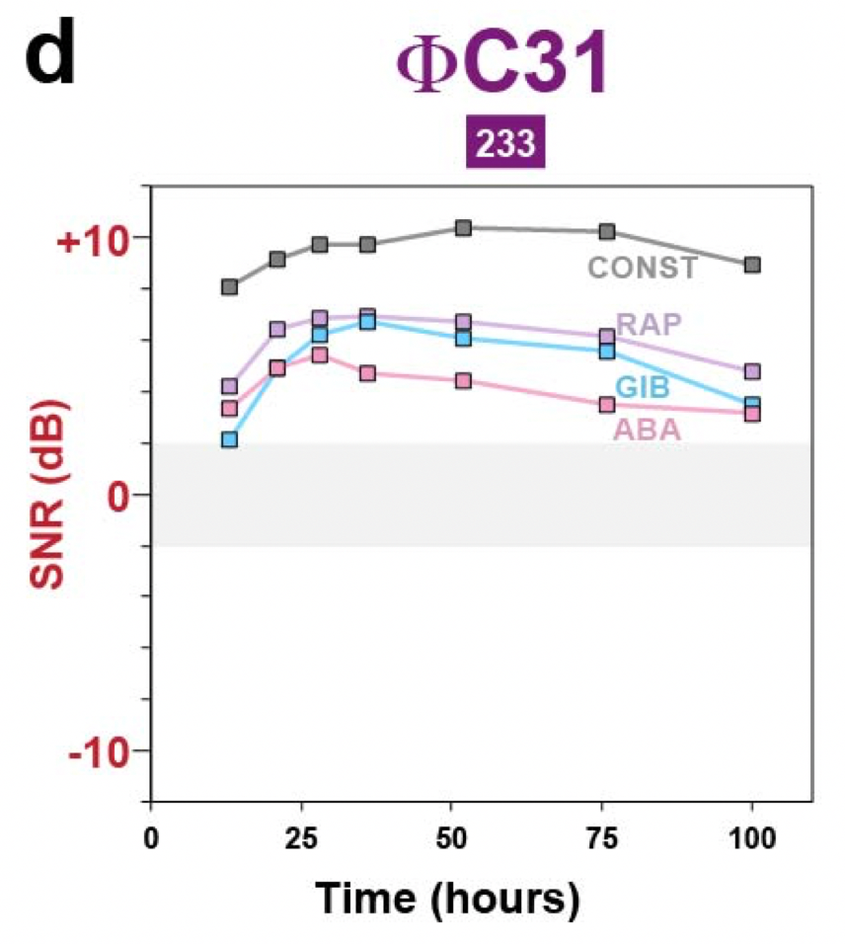
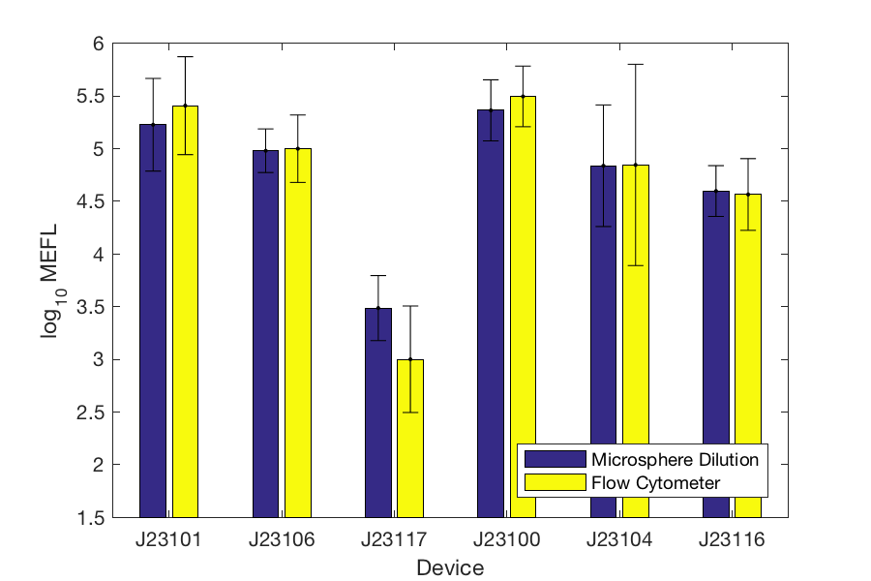
SynBio has the necessary ingredients
Precision
prediction
Promoter insulation
Pragmatic
models
predicted acceptable range
with model error
Better
devices
estimated property value
with measurement error
Calibrated
measurement
High-SNR devices
[Davidsohn et al, ACS SynBio, ‘15; Sexton & Tabor, MSB ‘20; Carr et al., PLOS ONE, ‘17; Weinberg et al, Natcomm, ‘19, Beal et al., PLOS ONE, ‘18]

Slide 9
What are the barriers to integration?
Looks pretty good?
Design
Specification
Interpretation
& Models
Learn
Design
Complete
Design
Analysis
Configuration
NA / Strain
Build Plan
Data &
Meta-Data
Build
Test
NA / Strain
Samples
Level 3: Conditional Autonomy
Experiment
Plan
Level 2: Partial Autonomy
Level 1: Investigator Assistance
Level 0: No Autonomy
[Beal & Rogers, MSB ‘20]
Notes:
CELLO is level 2 – to be level 3 it would need to be able to have its model adjusted when a circuit fails

Slide 10
Hidden cost: curation & configuration
Goals
Component
Specifications
Domain
Knowledge
Design
Specification
Interpretation
& Models
Learn
Design
Protocol
Specifications,
Inventory
Complete
Design
Analysis
Configuration
NA / Strain
Build Plan
Analytical
Tool APIs
Data &
Meta-Data
Build
Test
NA / Strain
Samples
Level 3: Conditional Autonomy
Experiment
Plan
Executable
Protocols
Level 2: Partial Autonomy
Executable
Protocols
Level 1: Investigator Assistance
Protocol
Specifications,
Inventory
Level 0: No Autonomy
[Beal & Rogers, MSB ‘20]
Notes:
CELLO is level 2 – to be level 3 it would need to be able to have its model adjusted when a circuit fails

Slide 11
SBOL 3: Representing the whole system
[Baig et al., JIB ’20, McLaughlin et al., FBB ‘20]

Slide 12







Agile Data Curation
Agile software tools:
Distributed version control
Automated build
Continuous integration
Issue tracking / boards
GitFlow & pull request reviews
Biological knowledge resources:
Bio DBTL as
code & logs
Maintain integration, automate checklists → focus on science

Slide 13







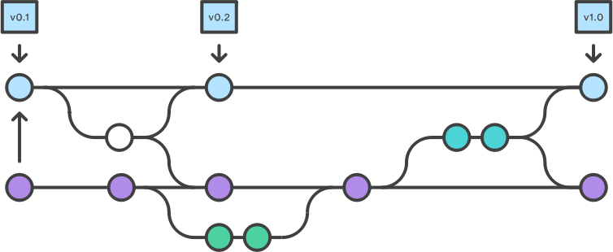



Example: iGEM 2022 Distribution
Validation pipeline
Collation & extraction
GitHub Actions
Gitflow Agile workflow: Pull requests & change review
Result: focus on design content, not sequence collation

Slide 14
What you can do to help
Choose open market business models
Choose free and open licenses
Use open standards
Develop open infrastructure
Adopt agile curation practices
Calibrate and share your data and models
Use other people’s data, protocols, models, tools
Contribute to open tools
Automate a little bit more every time
The three chief virtues of a programmer are: Laziness, Impatience and Hubris
- Larry Wall

